Slide 1
Market Research using Machine Learning Techniques for a New Car Company Entering The Space
Author: Gregory Hovesen
ID: 500769246
Section: D10
Supervisor: Dr. Kachana Padmanabhan
December 3rd, 2021

Slide 2









Resources Used

Slide 3
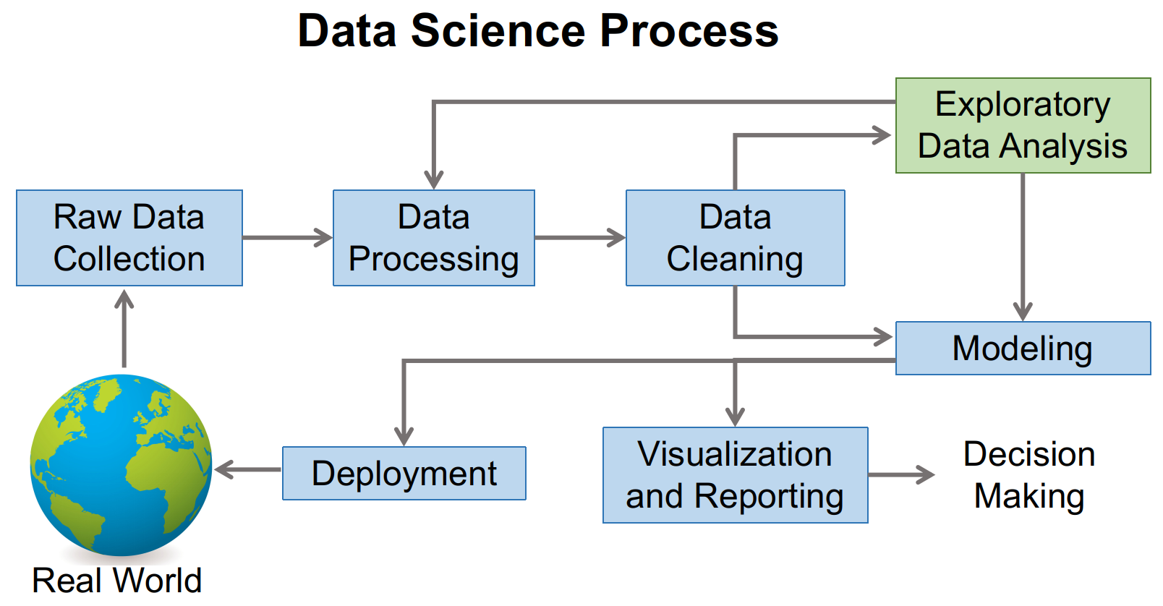
How?
Image by author, inspired by Farcaster at English Wikipedia

Slide 4
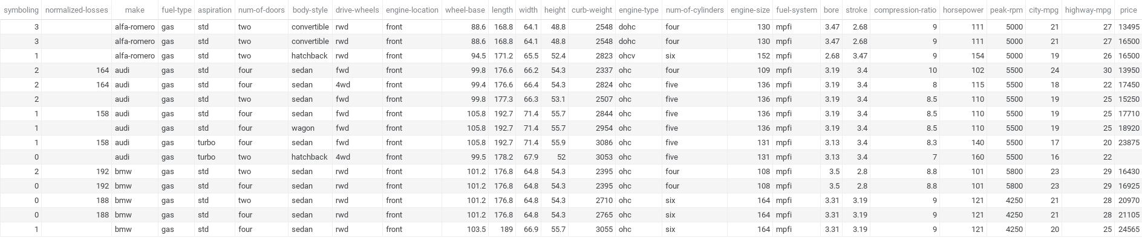
The Data
Pouyaaskari. (2021, January 15). Automobile-dataset. Kaggle. Retrieved September 27, 2021, from https://www.kaggle.com/pouyaaskari/automobile-dataset.

Slide 5
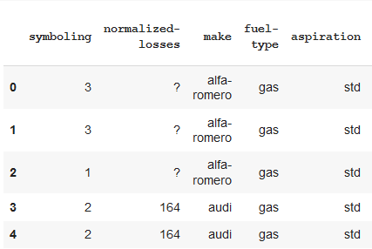
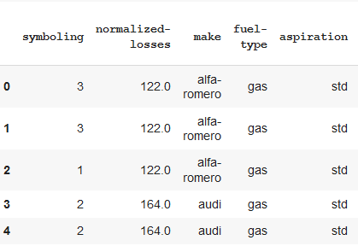
Cleaning

Slide 6
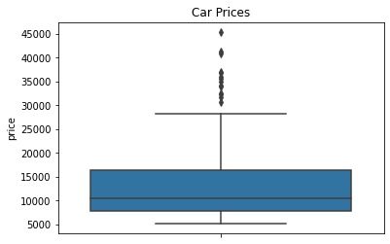
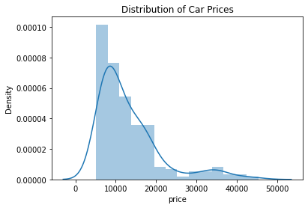
Target Variable

Slide 7
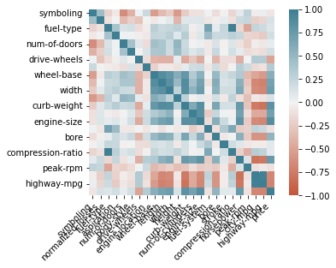
Correlation Matrix

Slide 8
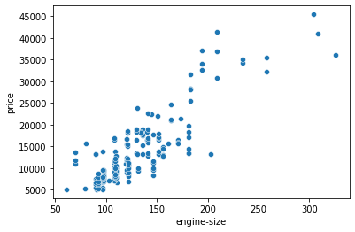
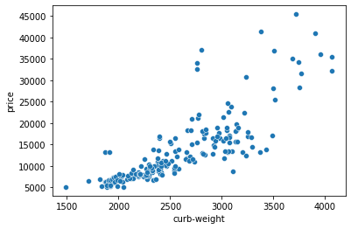
Target vs High Correlation

Slide 9
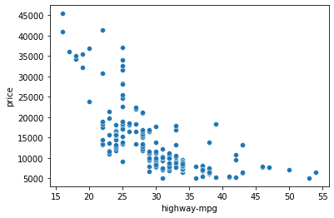
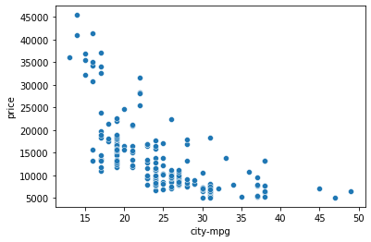
Target vs High
Negative-Correlation

Slide 10
Initial Model
Linear Regression Model Creation
from sklearn.model_selection import train_test_split
X = Cleaned_Data.loc[:, ['symboling', 'normalized-losses', 'fuel-type', 'aspiration', 'num-of-doors', 'body-style', 'drive-wheels', 'engine-location', 'wheel-base', 'length', 'width', 'height', 'curb-weight', 'num-of-cylinders', 'engine-size', 'fuel-system', 'bore', 'stroke', 'compression-ratio', 'horsepower', 'peak-rpm', 'city-mpg', 'highway-mpg']]
y = Cleaned_Data.loc[:,'price']
X_train, X_test, y_train, y_test = train_test_split(X, y, test_size = 0.3, random_state = 0)

Slide 11
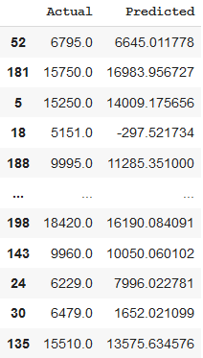
Initial Model - Results
Mean Absolute Error: 2929.7148881358653
Mean Squared Error: 19681481.204782143
Root Mean Squared Error: 4436.381544094483
R Squared Score: 0.6724444782976456
Explained Variance Score: 0.6770069282135331

Slide 12
Improvement Attempts
Model 1
Mean Absolute Error: 2929.7148881358653
Mean Squared Error: 19681481.204782143
Root Mean Squared Error: 4436.381544094483
R Squared Score: 0.6724444782976456
Explained Variance Score: 0.6770069282135331
Model 2
Mean Absolute Error: 2761.4515413827135
Mean Squared Error: 16448590.227534316
Root Mean Squared Error: 4055.686159891359
R Squared Score: 0.7262489292757532
Explained Variance Score: 0.7333128779324034
Model 3
Mean Absolute Error: 2658.4179500122423
Mean Squared Error: 15362685.307905115
Root Mean Squared Error: 3919.526158594316
R Squared Score: 0.7443214589175706
Explained Variance Score: 0.7506434129780915

Slide 13
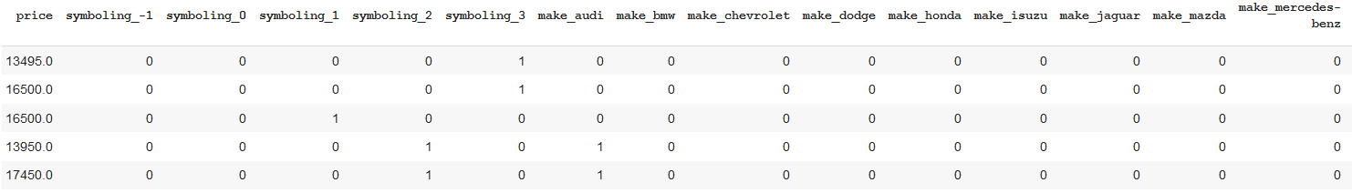
Final Improvements
Use of Dummy Variables
def dummy_var(x,df):
temp = pd.get_dummies(df[x], prefix=x, drop_first = True)
df = pd.concat([df, temp], axis = 1)
df.drop([x], axis = 1, inplace = True)
return df

Slide 14
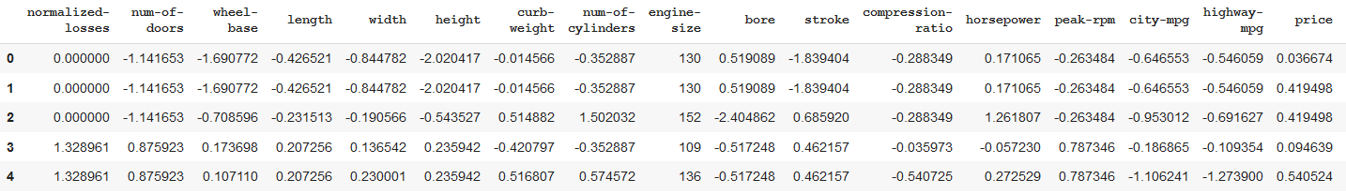
Final Improvements
Scaling
from sklearn.preprocessing import StandardScaler,scale
sc = StandardScaler()

Slide 15
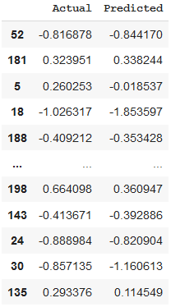
Final Model - Results
Mean Absolute Error: 0.2663366808764814
Mean Squared Error: 0.19654533129512172
Root Mean Squared Error: 0.44333433353973584
R Squared Score: 0.7984514450107454
Explained Variance Score: 0.8067557546099543

Slide 16
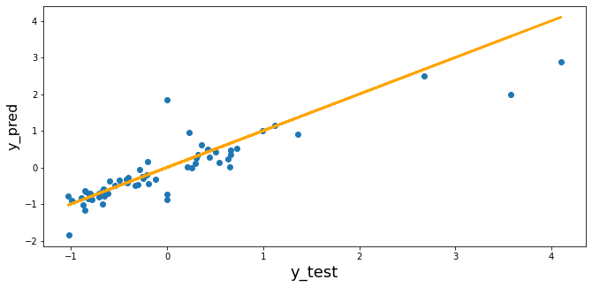
Final Model - Plot

Slide 17
Questions?
https://github.com/GHovCIND820/CIND820-Final-Project

